Slide 1
WELCOME

Slide 2
PRESENTATION ON PARTS OF COMPUTER
BY
TEJAS TEKE

Slide 3
COMPUTER PARTS
There are many parts that work together to make a computer work.

Slide 4
PARTS Of computer
1)HARDWARE 2)CPU 3)PROCESSOR
4)COMPUTER CASE 5)MONITOR 6)VIDEO CARD
7)KEYBOARD 8)HARD DISK 9)MOUSE
10)RAM

Slide 5
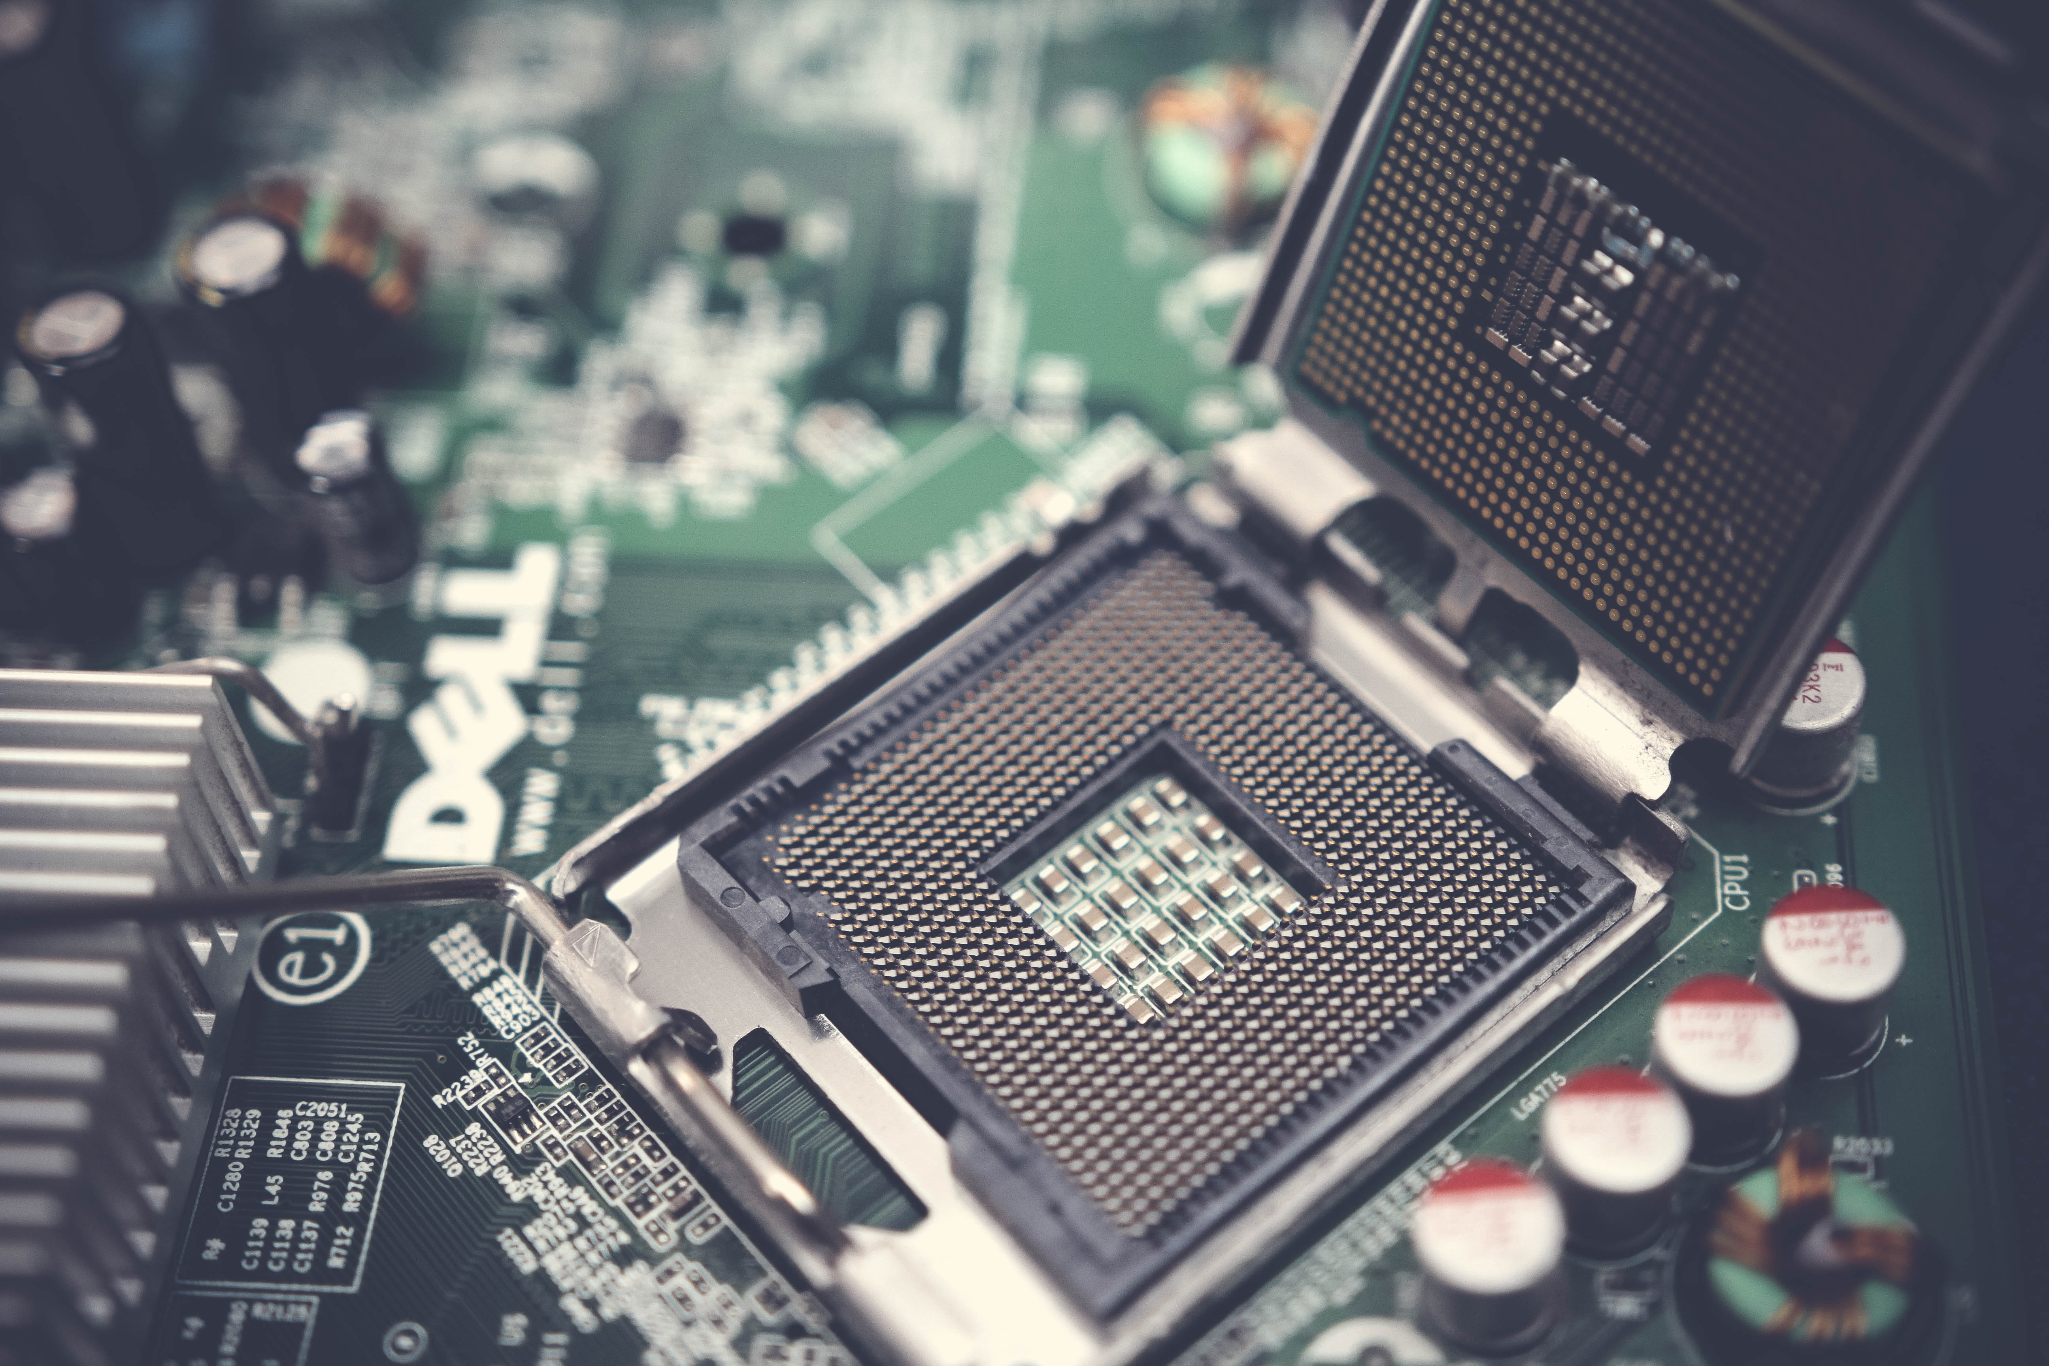
HARDWARE
Physical parts of the computer, including processor and memory chips, input/output devices, tapes, disks, modems, cable, etc.

Slide 6
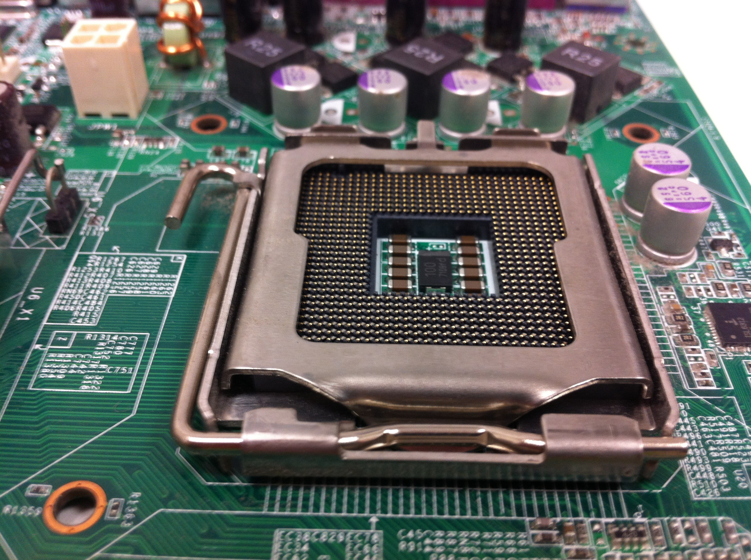
Central Processing Unit (CPU) ... The CPU is the brain of a computer, containing all the circuitry needed to process input, store data, and output results. The CPU is constantly following instructions of computer programs that tell it which data to process and how to process it.
CPU

Slide 7
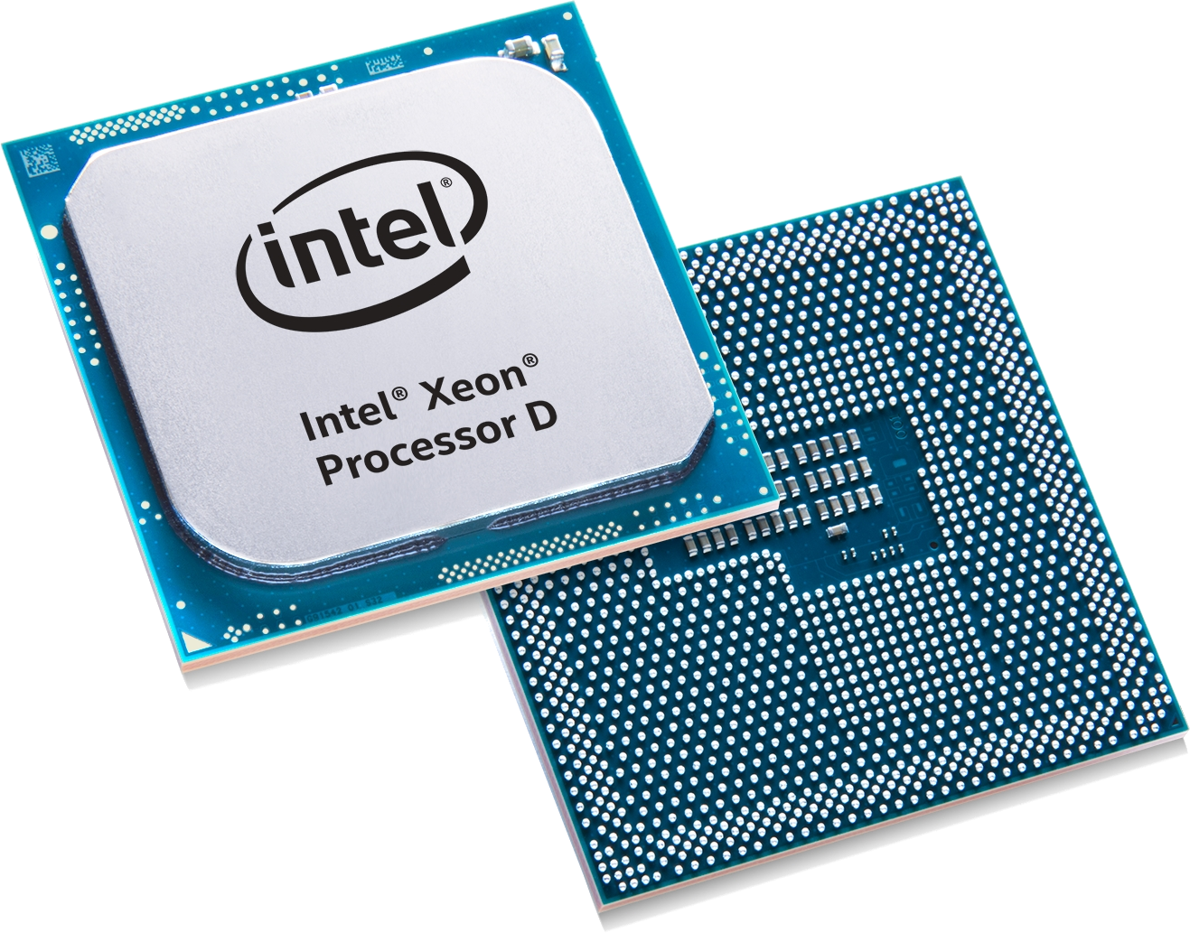
PROCESSOR
The CPU – The chip or chips that interpret and execute program instructions and manage the functions of input, output, and storage devices.
C

Slide 8
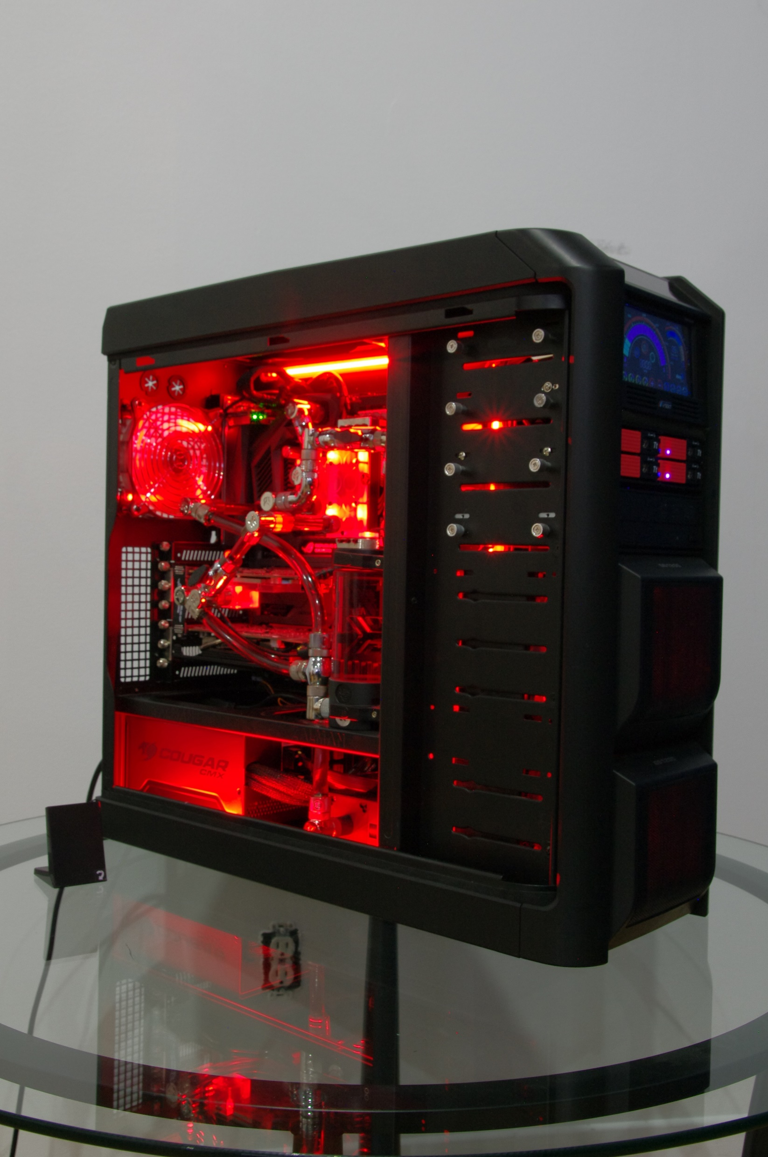
COMPUTER CASE
Contains the major components of the computer. It helps protect them

Slide 9
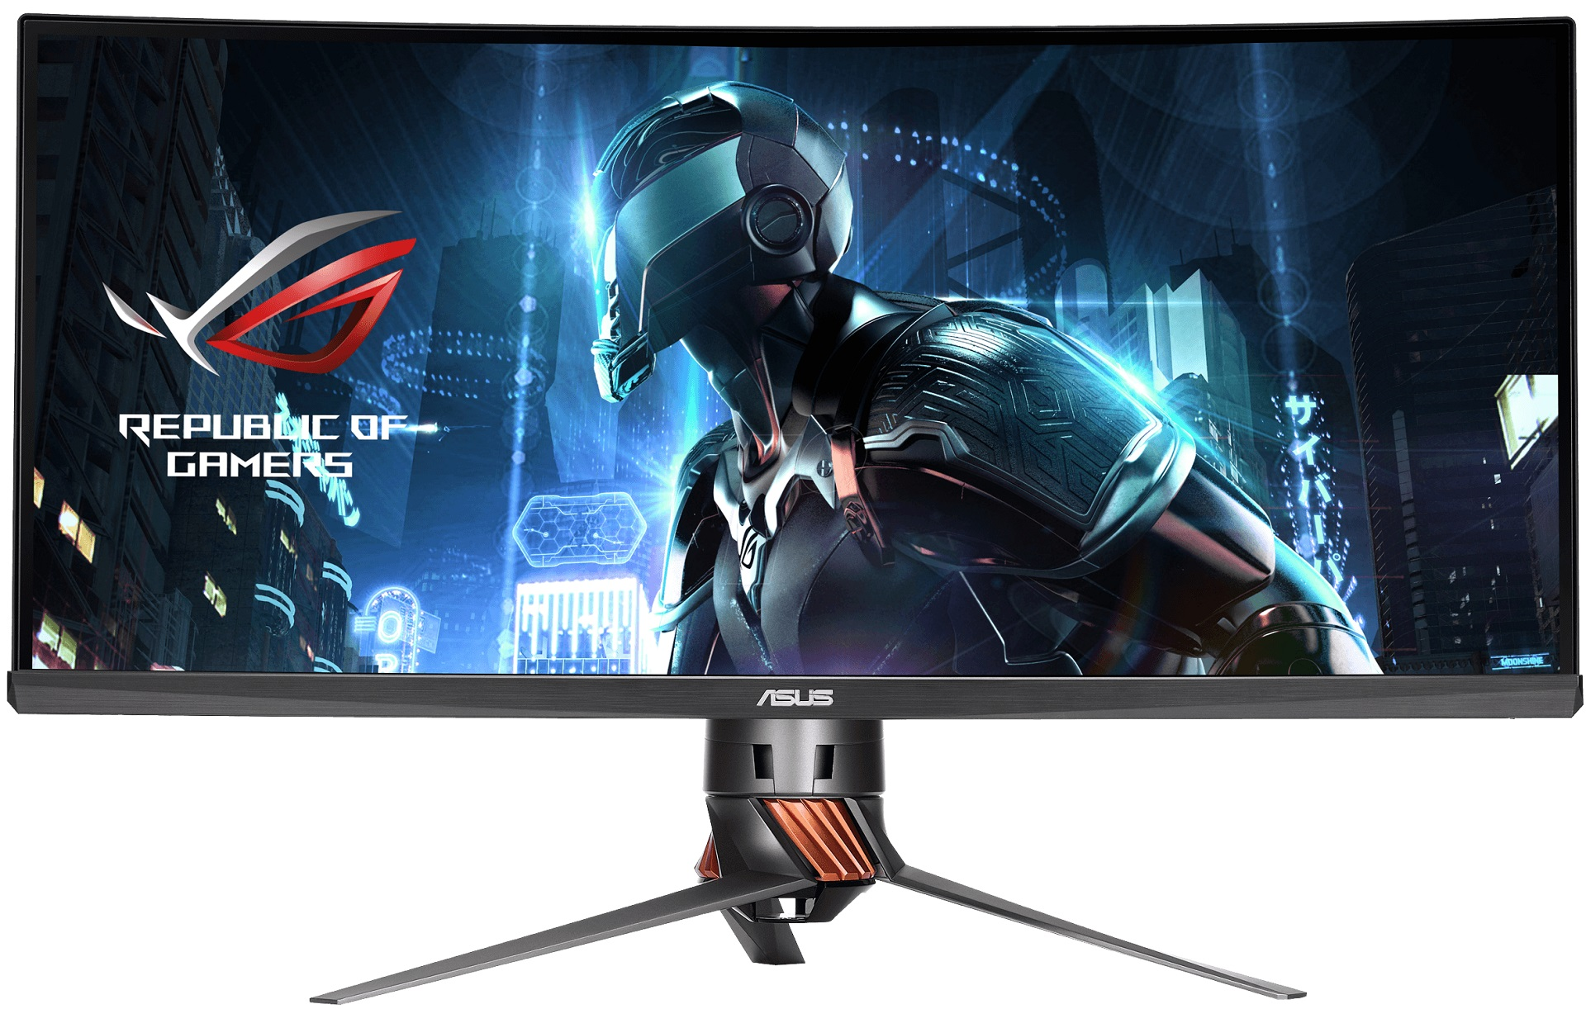
MONITOR
A display screen to provide “output” to the user. It is where you view the information your are working on

Slide 10
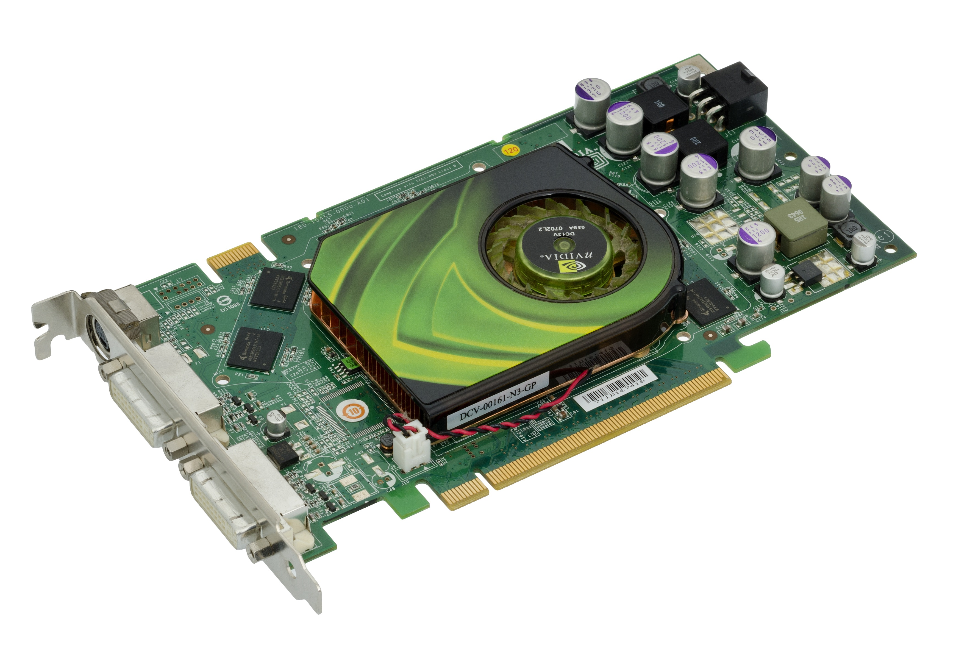
VIDEO CARD
Connects the computer to the monitor. It is a circuit board attached to the motherboard that contains the memory and other circuitry necessary to send information to the monitor for display on screen.

Slide 11
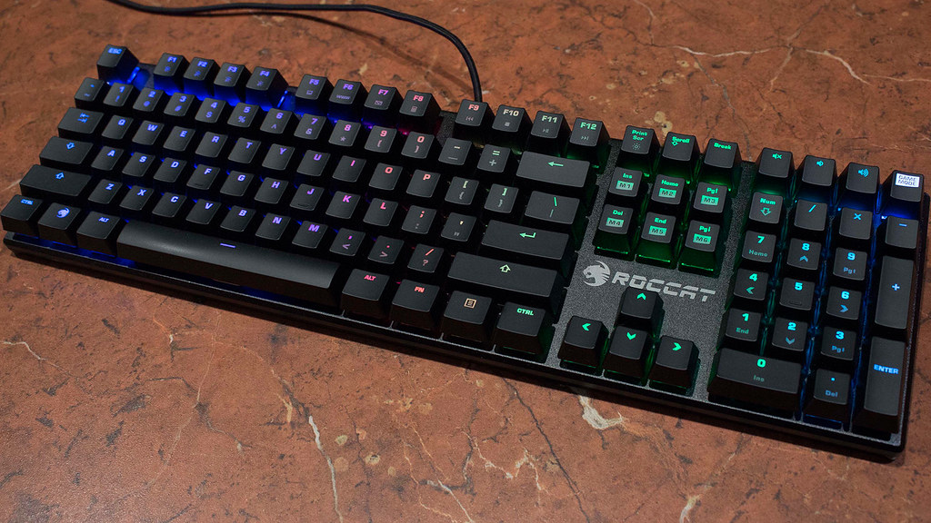
KEYBOARD
Used to enter information into the computer and for giving commands

Slide 12
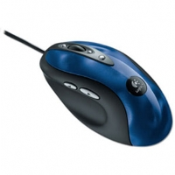
MOUSE
An input device operated by rolling its ball across a flat surface. The mouse is used to control the on-screen pointer by pointing and clicking, double-clicking, or dragging objects on the screen.

Slide 13
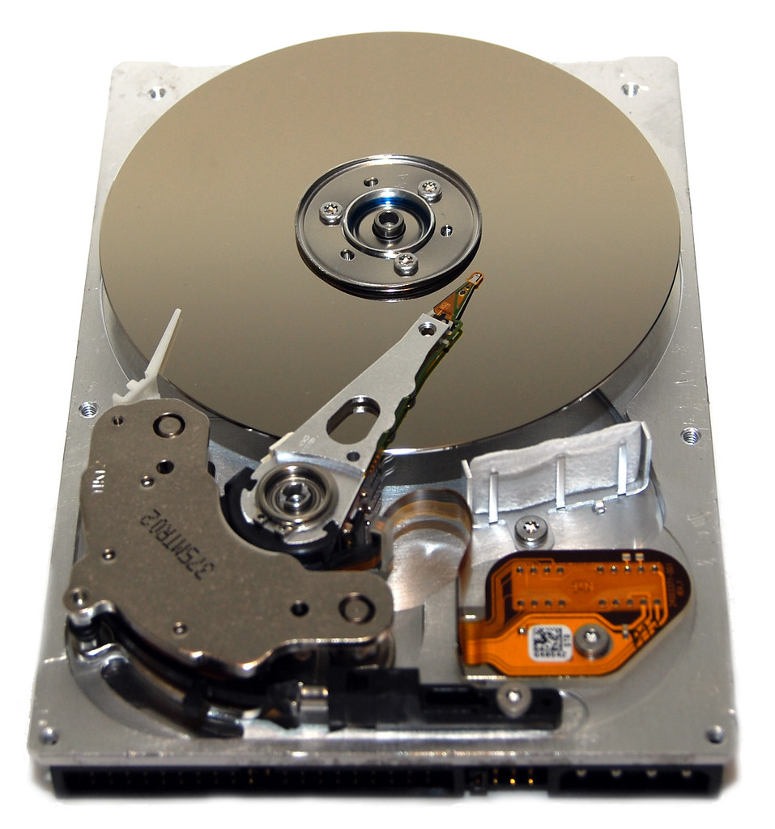
HARD DISK
Magnetic storage device in the computer.
CC BY

Slide 14
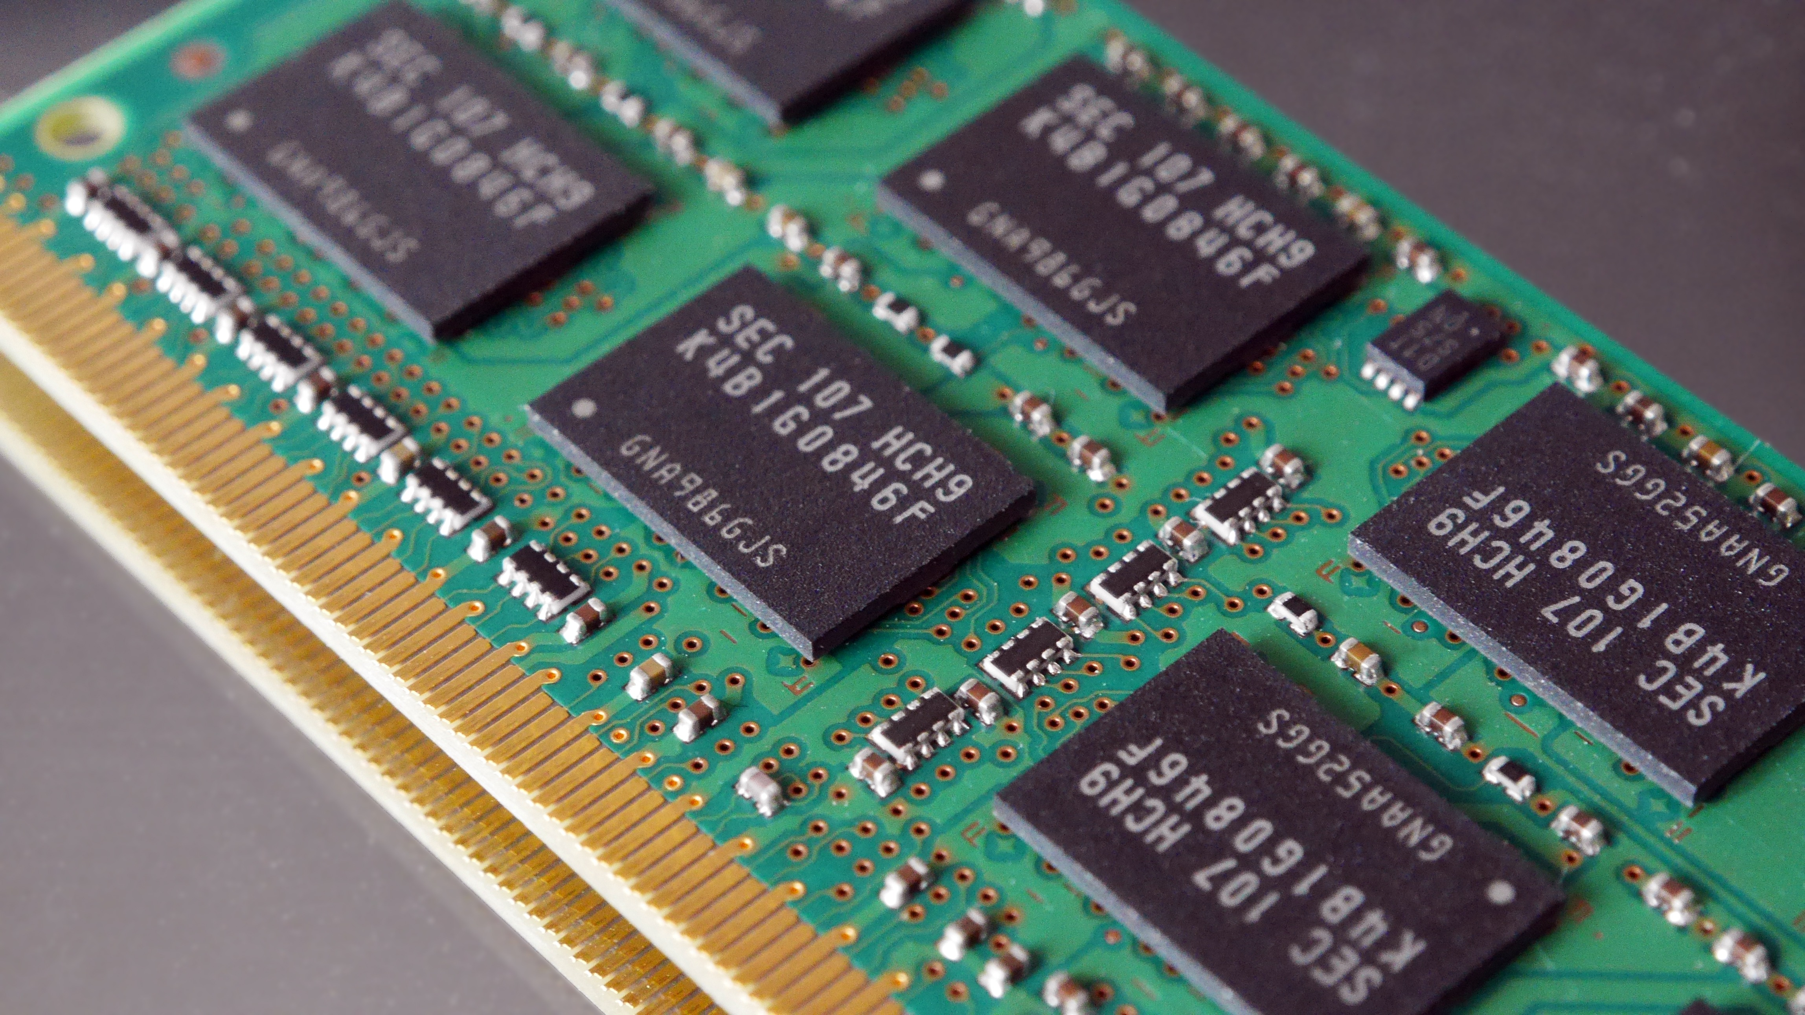
RAM
Random Access Memory
RAM is a computer’s temporary memory, which exists as chips on the motherboard near the CPU. It stores data or programs while they are being used and requires power.

Slide 15
THE END

